Slide 1
Generative Adversarial Networks

Slide 2

Generative Adversarial Networks (GANs)
Ian Goodfellow, OpenAI Research Scientist
NIPS 2016 tutorial
Barcelona, 2016-12-4

Slide 3
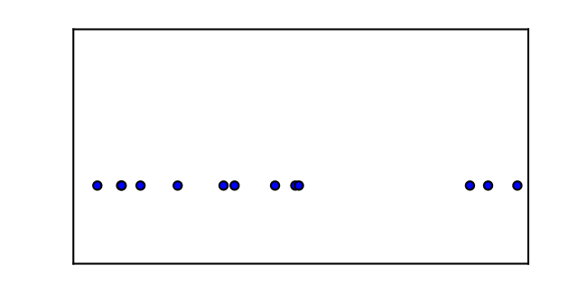
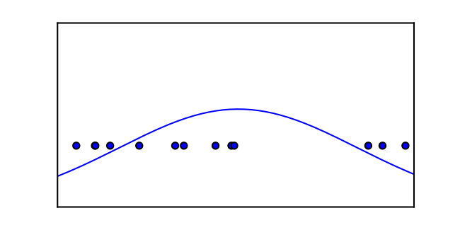
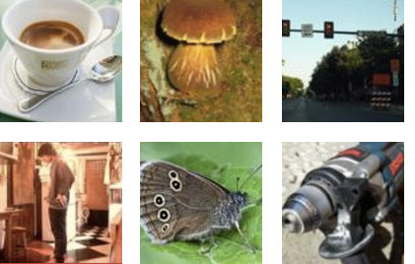
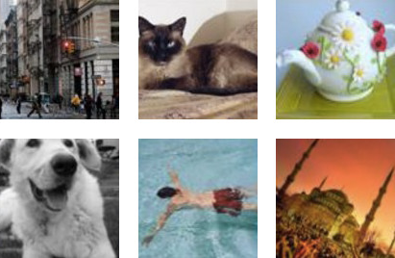
Generative Modeling
Density estimation
Sample generation
Training examples
Model samples

Slide 4
Why study generative models?
Excellent test of our ability to use high-dimensional, complicated probability distributions
Simulate possible futures for planning or simulated RL
Missing data
Semi-supervised learning
Multi-modal outputs
Realistic generation tasks

Slide 5
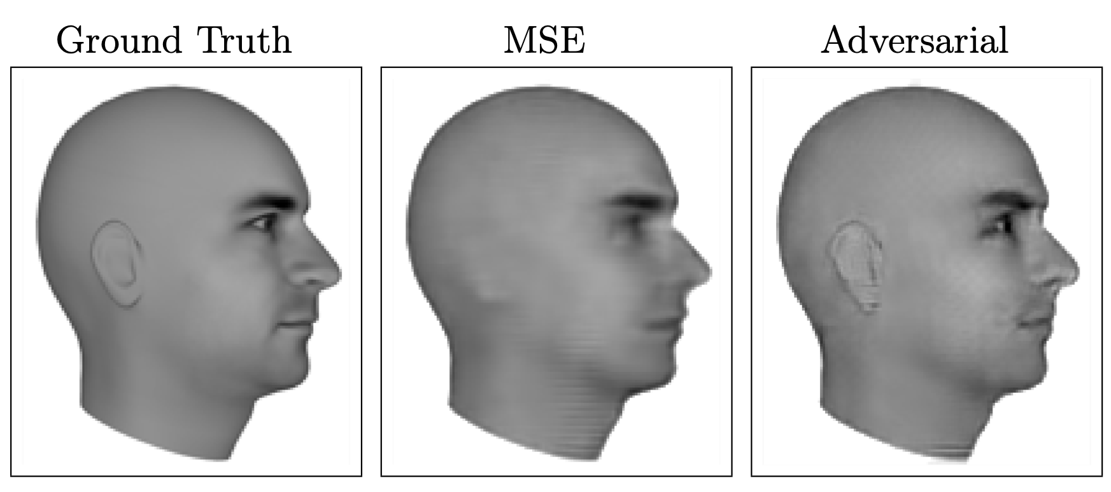
Next Video Frame Prediction
(Lotter et al 2016)

Slide 6
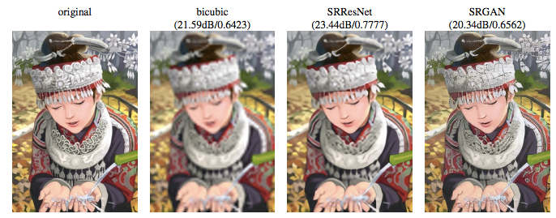
Single Image Super-Resolution
(Ledig et al 2016)

Slide 7
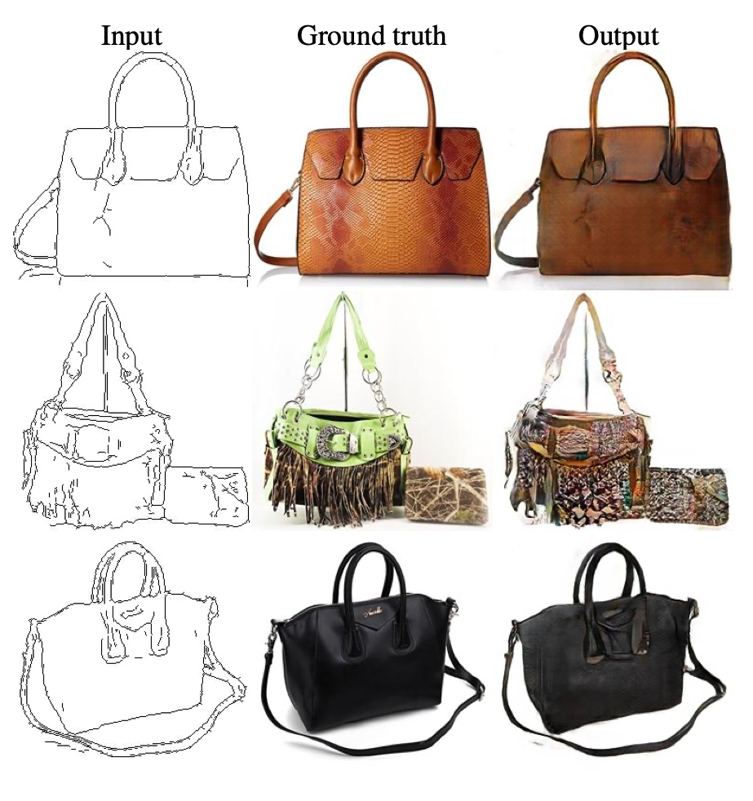
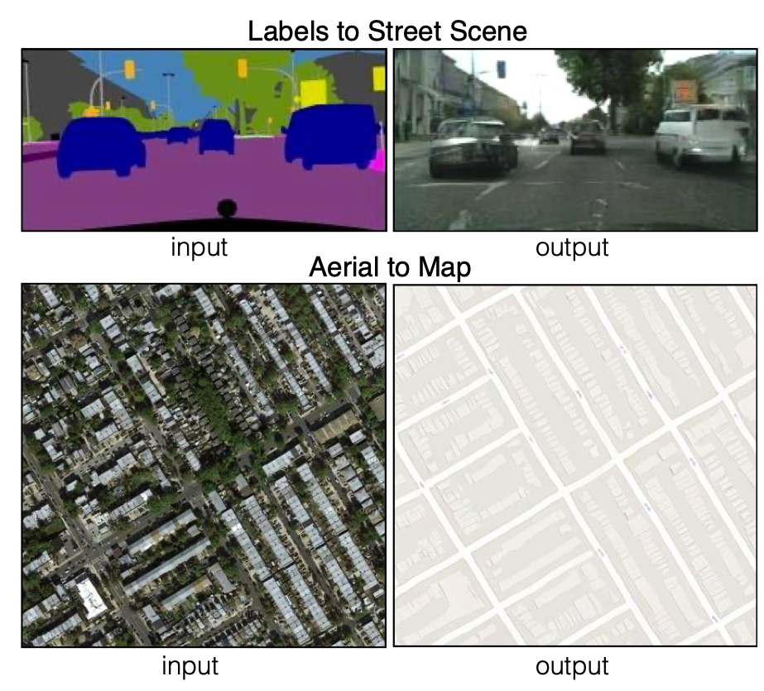
Image to Image Translation
(Isola et al 2016)

Slide 8
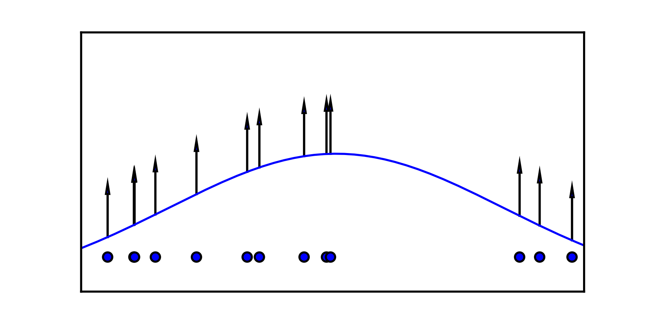
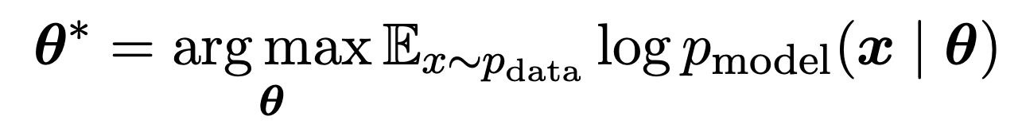
Maximum Likelihood

Slide 9

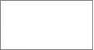
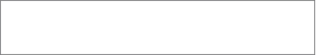
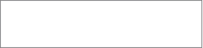
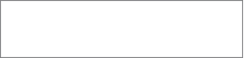
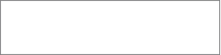


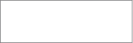
Taxonomy of Generative Models
…
Direct
Maximum Likelihood
GAN
Explicit density
Implicit density
Markov Chain
Tractable density
Approximate density
GSN
-Fully visible belief nets
-NADE
-MADE
-PixelRNN
-Change of variables models (nonlinear ICA)
Variational
Markov Chain
Variational autoencoder
Boltzmann machine

Slide 10
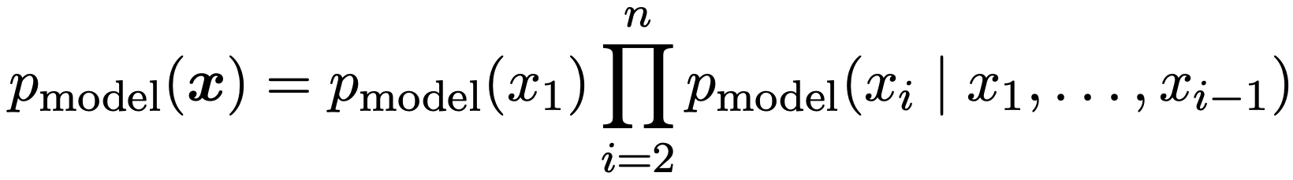
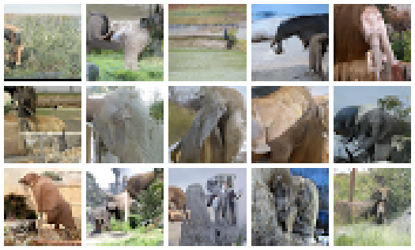
Fully Visible Belief Nets
Explicit formula based on chain rule:
Disadvantages:
O(n) sample generation cost
Generation not controlled by a latent code
(Frey et al, 1996)
PixelCNN elephants
(van den Ord et al 2016)

Slide 11
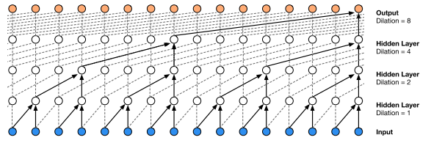
WaveNet
Amazing quality
Sample generation slow
Two minutes to synthesize one second of audio

Slide 12
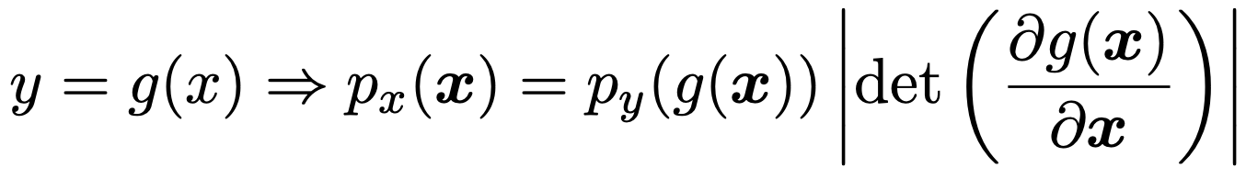
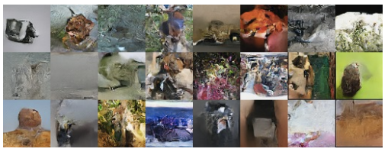
Change of Variables
e.g. Nonlinear ICA (Hyvärinen 1999)
Disadvantages:
Transformation must be invertible
Latent dimension must match visible dimension
64x64 ImageNet Samples
Real NVP (Dinh et al 2016)

Slide 13
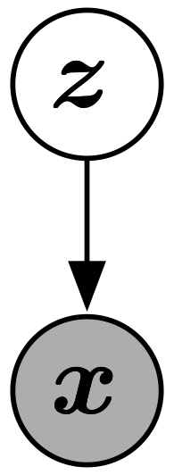
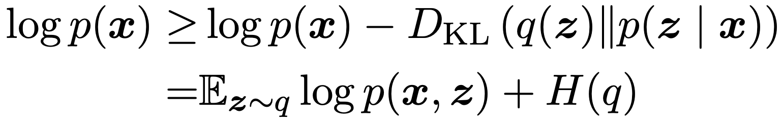
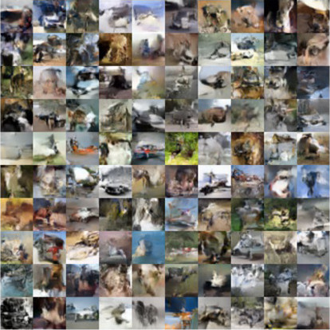
Variational Autoencoder
(Kingma and Welling 2013, Rezende et al 2014)
Disadvantages:
-Not asymptotically consistent unless q is perfect
-Samples tend to have lower quality
CIFAR-10 samples
(Kingma et al 2016)

Slide 14
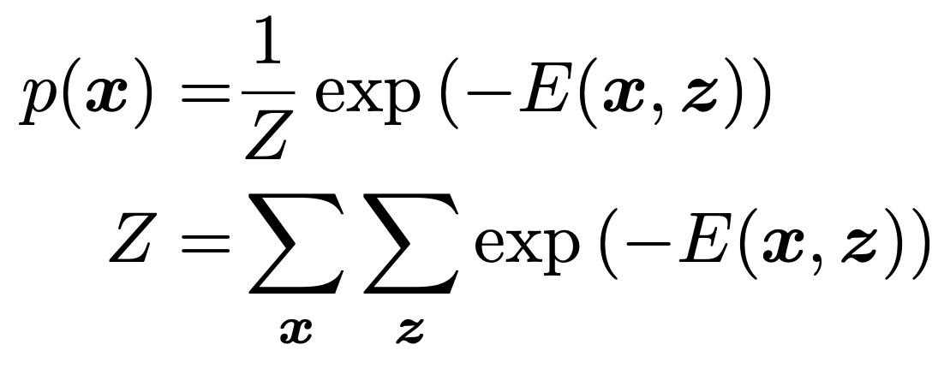
Boltzmann Machines
Partition function is intractable
May be estimated with Markov chain methods
Generating samples requires Markov chains too

Slide 15
GANs
Use a latent code
Asymptotically consistent (unlike variational methods)
No Markov chains needed
Often regarded as producing the best samples
No good way to quantify this

Slide 16
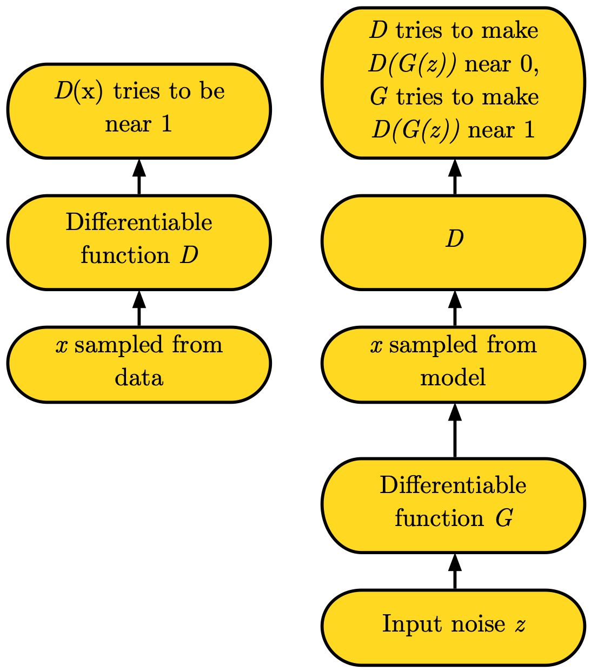
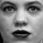
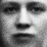
Adversarial Nets Framework

Slide 17
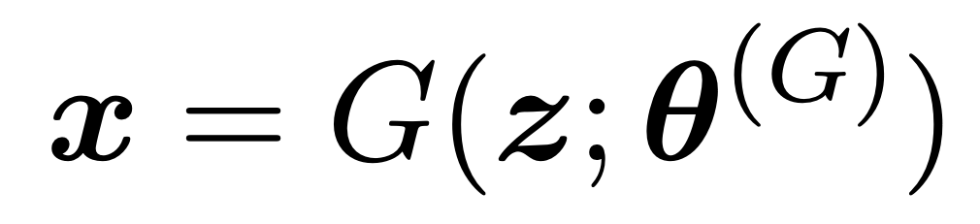
Generator Network
Must be differentiable
No invertibility requirement
Trainable for any size of z
Some guarantees require z to have higher dimension than x

Slide 18
Training Procedure
Use SGD-like algorithm of choice (Adam) on two minibatches simultaneously:
A minibatch of training examples
A minibatch of generated samples
Optional: run k steps of one player for every step of the other player.

Slide 19
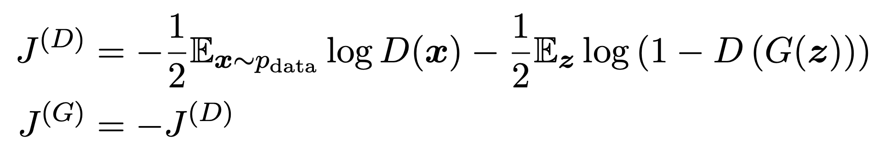
Minimax Game
Equilibrium is a saddle point of the discriminator loss
Resembles Jensen-Shannon divergence
Generator minimizes the log-probability of the discriminator being correct

Slide 20
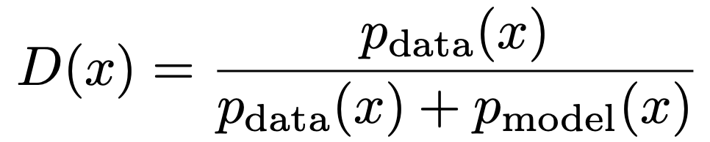
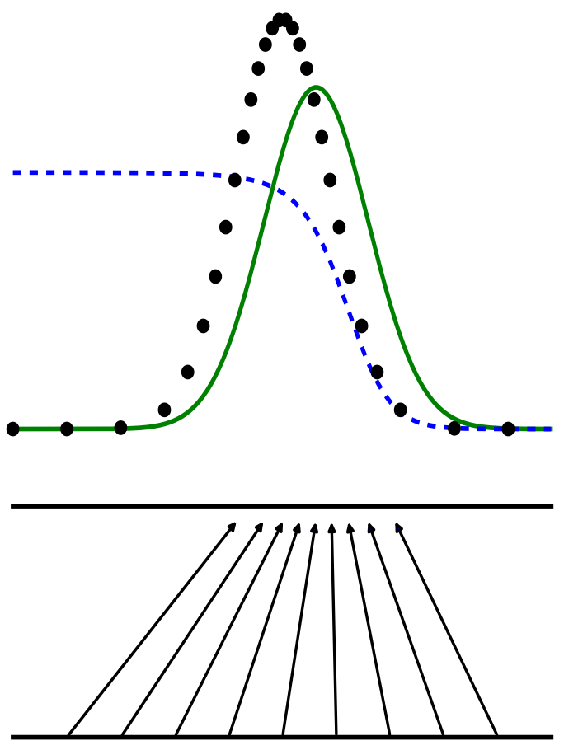
Discriminator Strategy
Discriminator
Data distribution
Model distribution
Estimating this ratio
using supervised learning is
the key approximation mechanism used by GANs
x
z

Slide 21
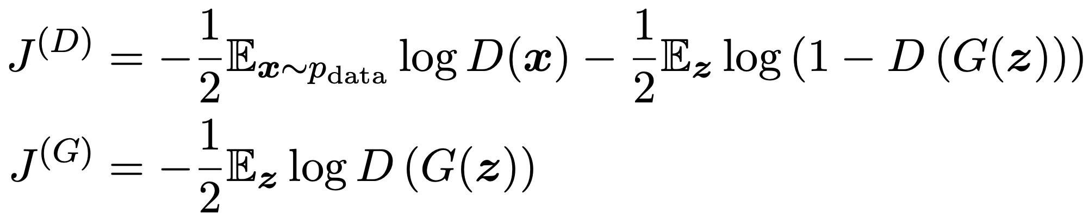
Non-Saturating Game
Equilibrium no longer describable with a single loss
Generator maximizes the log-probability of the discriminator being mistaken
Heuristically motivated; generator can still learn even when discriminator successfully rejects all generator samples

Slide 22
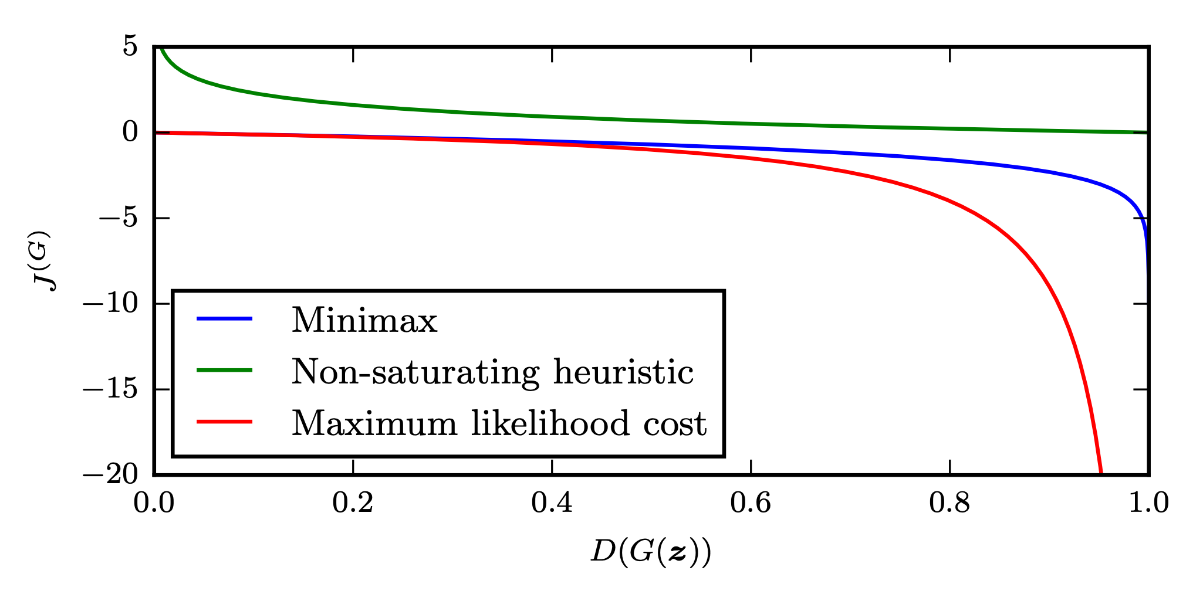
Comparison of Generator Losses
(Goodfellow 2014)

Slide 23
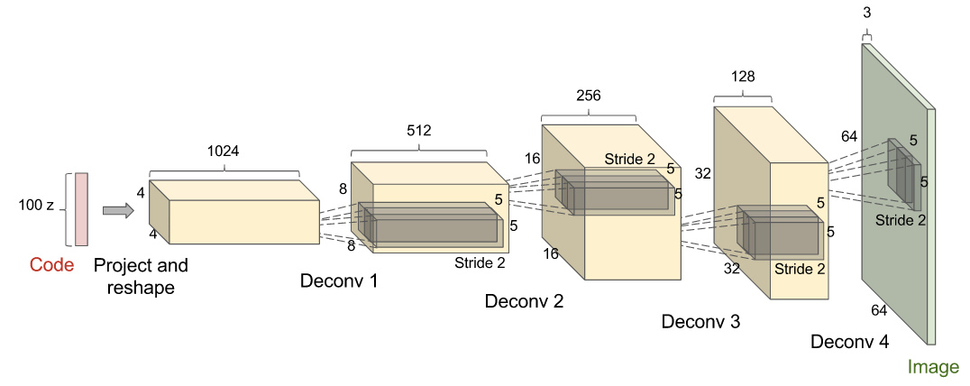
DCGAN Architecture
Most “deconvs” are batch normalized
(Radford et al 2015)

Slide 24
DCGANs for LSUN Bedrooms
(Radford et al 2015)

Slide 25
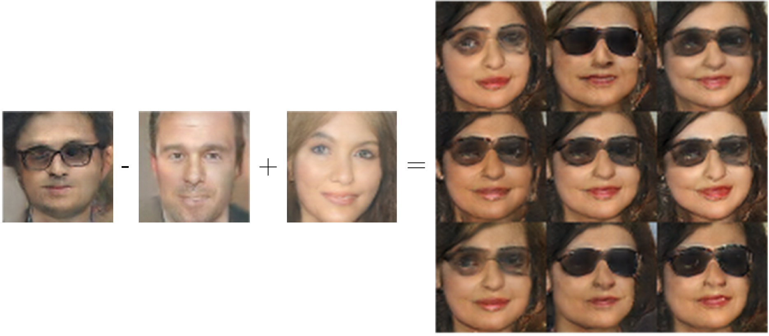
Vector Space Arithmetic
Man
with glasses
Man
Woman
Woman with Glasses
(Radford et al, 2015)

Slide 26
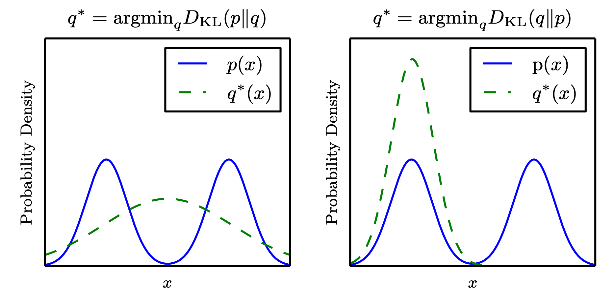
Is the divergence important?
Maximum likelihood
Reverse KL
(Goodfellow et al 2016)

Slide 27
Loss does not seem to explain why GAN samples are sharp
KL
Reverse
KL
(Nowozin et al 2016)
KL samples from LSUN
Takeaway: the approximation strategy matters more than the loss

Slide 28
One-sided label smoothing
Default discriminator cost:
One-sided label smoothed cost (Salimans et al 2016):
cross_entropy(1., discriminator(data))
+ cross_entropy(0., discriminator(samples))
cross_entropy(.9, discriminator(data))
+ cross_entropy(0., discriminator(samples))

Slide 29
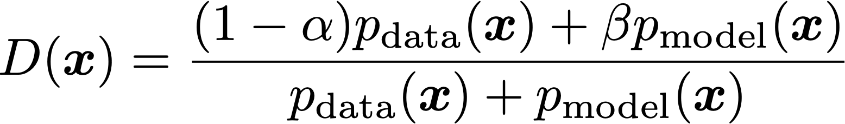
Do not smooth negative labels
cross_entropy(1.-alpha, discriminator(data))
+ cross_entropy(beta, discriminator(samples))
Reinforces current generator behavior

Slide 30
Benefits of label smoothing
Good regularizer (Szegedy et al 2015)
Does not reduce classification accuracy, only confidence
Benefits specific to GANs:
Prevents discriminator from giving very large gradient signal to generator
Prevents extrapolating to encourage extreme samples

Slide 31
Batch Norm
Given inputs X={x⁽¹⁾, x⁽²⁾, .., x^{(m)}}
Compute mean and standard deviation of features of X
Normalize features (subtract mean, divide by standard deviation)
Normalization operation is part of the graph
Backpropagation computes the gradient through the normalization
This avoids wasting time repeatedly learning to undo the normalization

Slide 32
Batch norm in G can cause strong intra-batch correlation

Slide 33
Balancing G and D
Usually the discriminator “wins”
This is a good thing—the theoretical justifications are based on assuming D is perfect
Usually D is bigger and deeper than G
Sometimes run D more often than G. Mixed results.
Do not try to limit D to avoid making it “too smart”
Use non-saturating cost
Use label smoothing

Slide 34
Non-convergence
Optimization algorithms often approach a saddle point or local minimum rather than a global minimum
Game solving algorithms may not approach an equilibrium at all

Slide 35
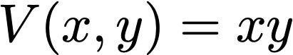
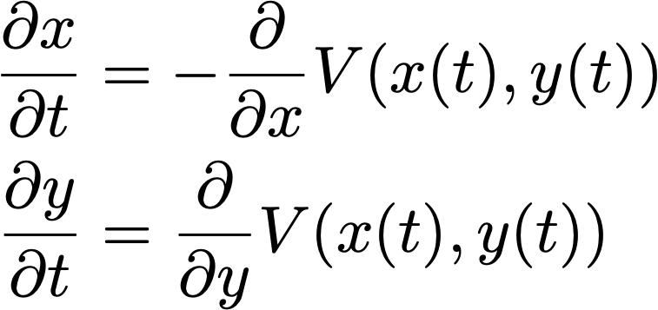
Exercise 2
For scalar x and y, consider the value function:
Does this game have an equilibrium? Where is it?
Consider the learning dynamics of simultaneous gradient descent with infinitesimal learning rate (continuous time). Solve for the trajectory followed by these dynamics.

Slide 36
Solution
This is the canonical example of
a saddle point.
There is an equilibrium, at
x = 0, y = 0.

Slide 37
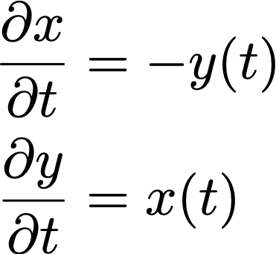
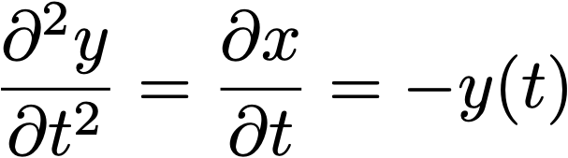
Solution
The gradient dynamics are:
Differentiating the second equation, we obtain:
We recognize that y(t) must be a sinusoid

Slide 38
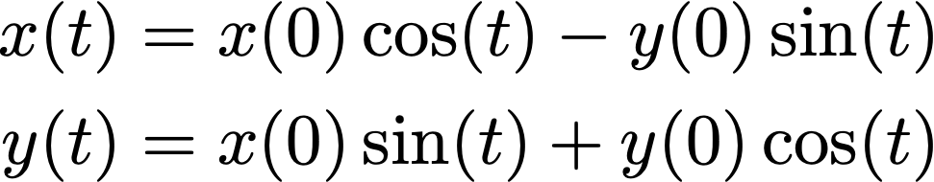
Solution
The dynamics are a circular orbit:
Discrete time gradient descent can spiral outward for large step sizes

Slide 39
Non-convergence in GANs
Exploiting convexity in function space, GAN training is theoretically guaranteed to converge if we can modify the density functions directly, but:
Instead, we modify G (sample generation function) and D (density ratio), not densities
We represent G and D as highly non-convex parametric functions
“Oscillation”: can train for a very long time, generating very many different categories of samples, without clearly generating better samples
Mode collapse: most severe form of non-convergence

Slide 40
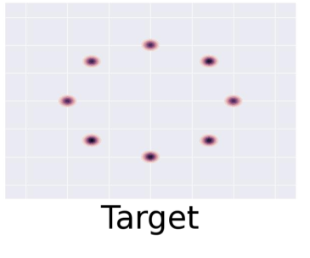
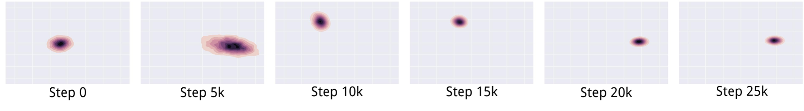
Mode Collapse
D in inner loop: convergence to correct distribution
G in inner loop: place all mass on most likely point
(Metz et al 2016)

Slide 41
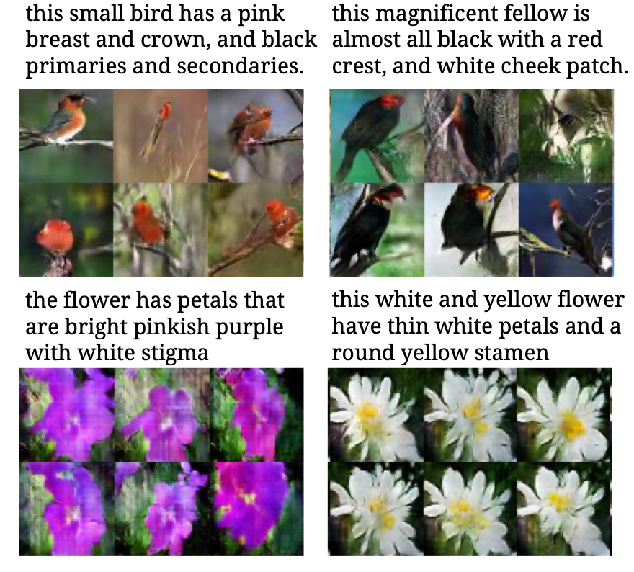
Mode collapse causes low output diversity
(Reed et al, submitted to
ICLR 2017)
(Reed et al 2016)

Slide 42
Minibatch Features
Add minibatch features that classify each example by comparing it to other members of the minibatch (Salimans et al 2016)
Nearest-neighbor style features detect if a minibatch contains samples that are too similar to each other

Slide 43
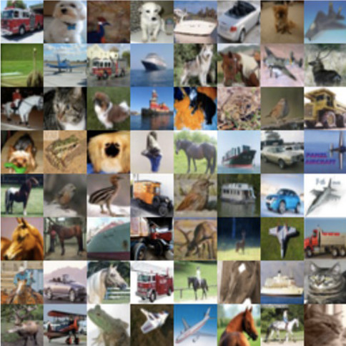
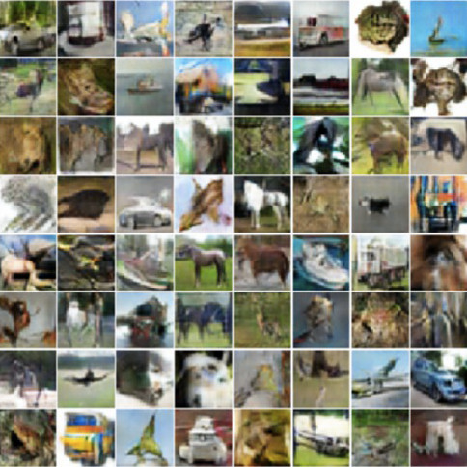
Minibatch GAN on CIFAR
Training Data
Samples
(Salimans et al 2016)

Slide 44
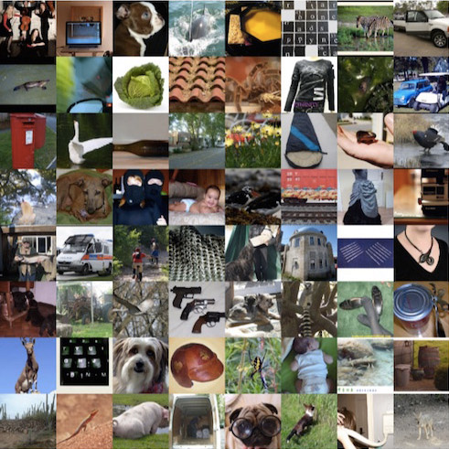
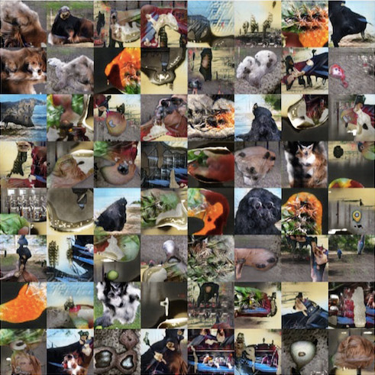
Minibatch GAN on ImageNet
(Salimans et al 2016)

Slide 45
Cherry-Picked Results

Slide 46
Problems with Counting

Slide 47
Problems with Perspective

Slide 48

Problems with Global Structure

Slide 50

Conditional GAN

Slide 51
This one is real

Slide 52
Generative Modeling:
Sample Generation
Training Data
Sample Generator
(CelebA)
(Karras et al, 2017)

Slide 53


Slide 54
Self-Attention GAN
State of the art FID on ImageNet: 1000 categories, 128x128 pixels
Goldfish
Redshank
Geyser
Tiger Cat
Broccoli
Stone Wall
Indigo Bunting
Saint Bernard
(Zhang et al., 2018)

Slide 55
Evaluation
There is not any single compelling way to evaluate a generative model
Models with good likelihood can produce bad samples
Models with good samples can have bad likelihood
There is not a good way to quantify how good samples are
For GANs, it is also hard to even estimate the likelihood
See “A note on the evaluation of generative models,” Theis et al 2015, for a good overview

Slide 56

Supervised Discriminator
Real
Fake
Real cat
Real dog
Fake
Hidden units
Hidden units
Input
Input
(Odena 2016, Salimans et al 2016)

Slide 57
Conclusion
GANs are generative models that use supervised learning to approximate an intractable cost function
GANs can simulate many cost functions, including the one used for maximum likelihood
Finding Nash equilibria in high-dimensional, continuous, non-convex games is an important open research problem
GANs are a key ingredient of PPGNs, which are able to generate compelling high resolution samples from diverse image classes

Slide 58


GAN ZOO

